Slide 1
Predicting UC Admissions
Barak Krakauer
July, 2016

Slide 2
The Task
I want to create a model that will forecast, based on available data, whether a student will be admitted into UC.
This would be useful (of course) to students, parents, and guidance counselors, but also to policy makers and social workers who are interested in improving access to higher education.
This is also related to bigger questions about what broader social and economic factors contribute to getting into higher education (and receiving the benefits that come from it).

Slide 3
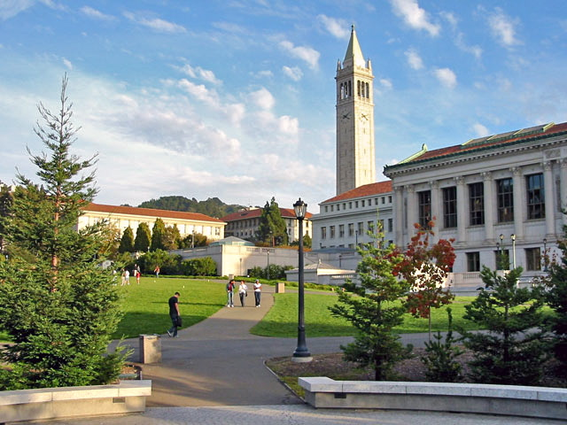
Will my kid get in to
Berkeley???

Slide 4
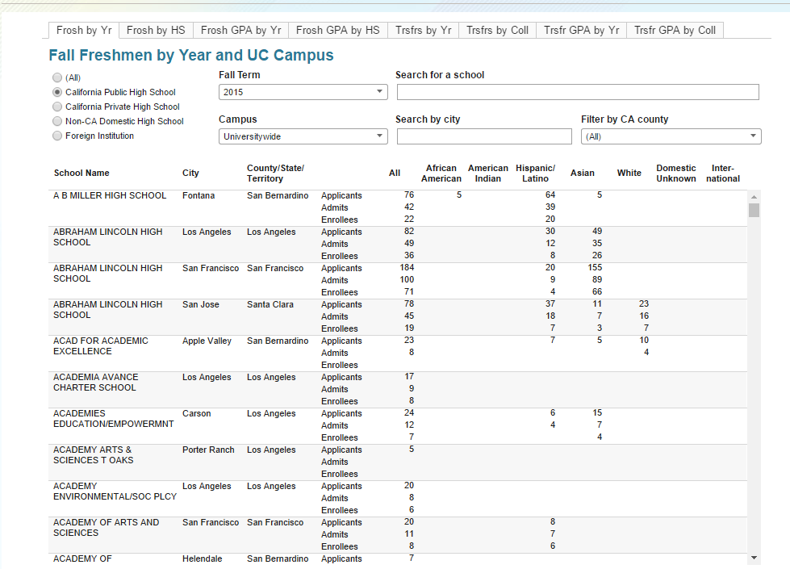
Gathering data
Data about the UC 2015
incoming class, by HS.
(For each HS, the number of
applicants and accepted
students, broken down by
race and ethnicity, plus the
mean GPA of applicants and
admittees)

Slide 5
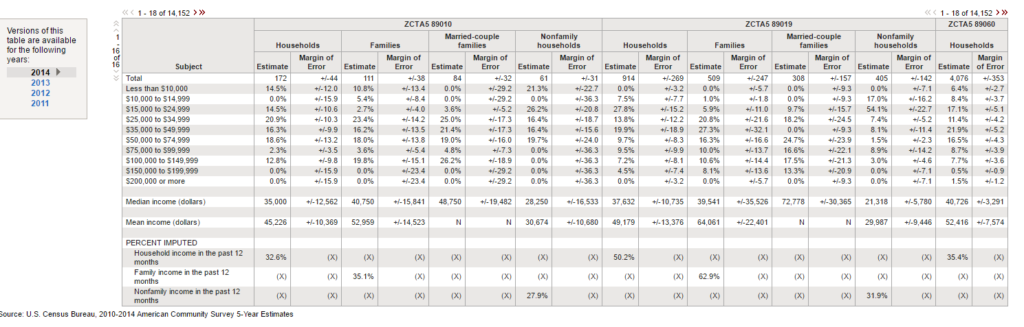
Gathering data
Household median income, by zip code (2014)

Slide 6
Refining Data
This gives me academic, ethnic, and economic data for the 3,670 high schools in the state, but this isn’t quite the data that I want.
I could use this to build models about (say) high schools with the highest rate of admissions, but I really want student-level data.

Slide 7
Refining Data
I simulated student-level data from the high school data:
For each high school, I would take the number of applicants from that high school and assign them ethnicities that match the makeup of applicants from that HS.
I assign that student an “income” that matches their city’s median household income.
I would assign them a randomized GPA (from a normal distribution centered on the mean GPA of applicants from that school)
I would then “admit” the students with the highest GPAs so that the right number of students from that school were admitted.
I now have something like student-level data for the 90,488 students that applied!

Slide 8
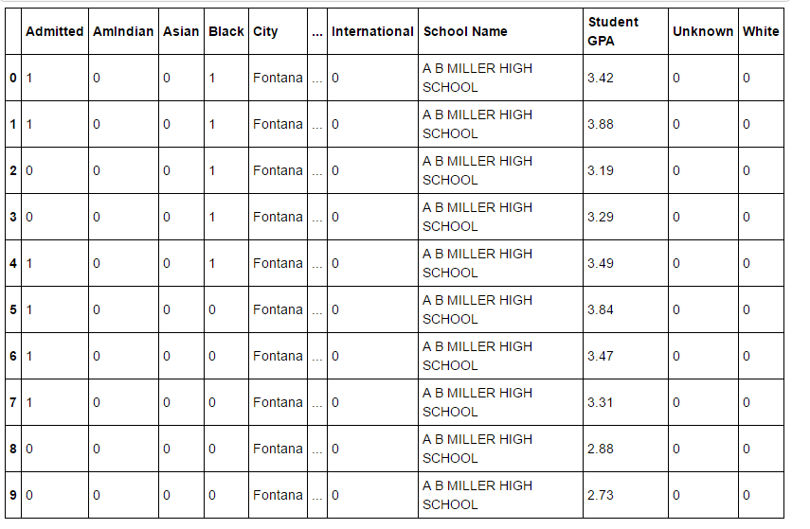
Refining Data

Slide 9
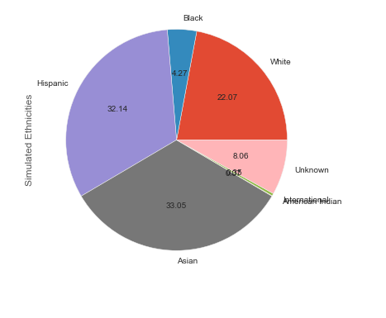
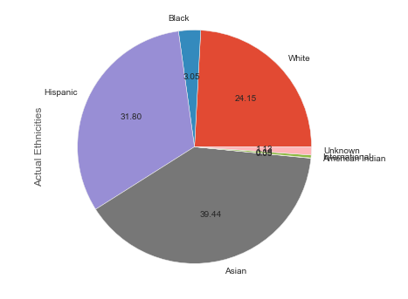
… but how accurate is this data?

Slide 10
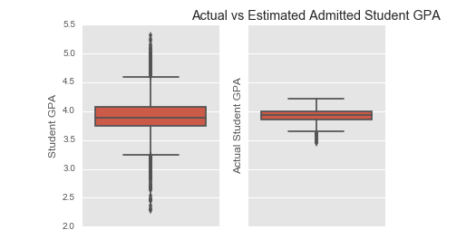
… but how accurate is this data?

Slide 11
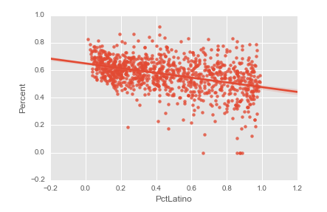
Data Exploration
There are some real correlations between the ethnic makeup of a school and its admissions rate…

Slide 12
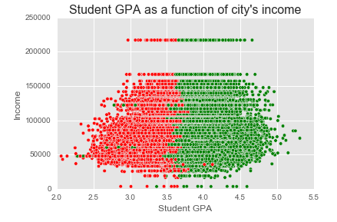
Data Exploration
… but there is a stronger correlation with income, and a still stronger correlation with student GPA…

Slide 13
Data Exploration
… but there is a stronger correlation with income, and a still stronger correlation with student GPA…
Also! Notice the
clean “locality” of
our admits and
non-admits!

Slide 14
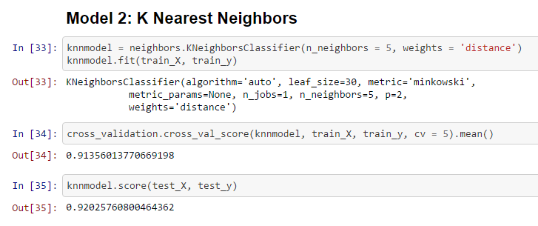
Building a model
I built some quick n’ dirty models to see what would work (including a logistic regression with a normalized scale for income and a random forest) but the most promising model was, as I suspected, a KNN model.

Slide 15
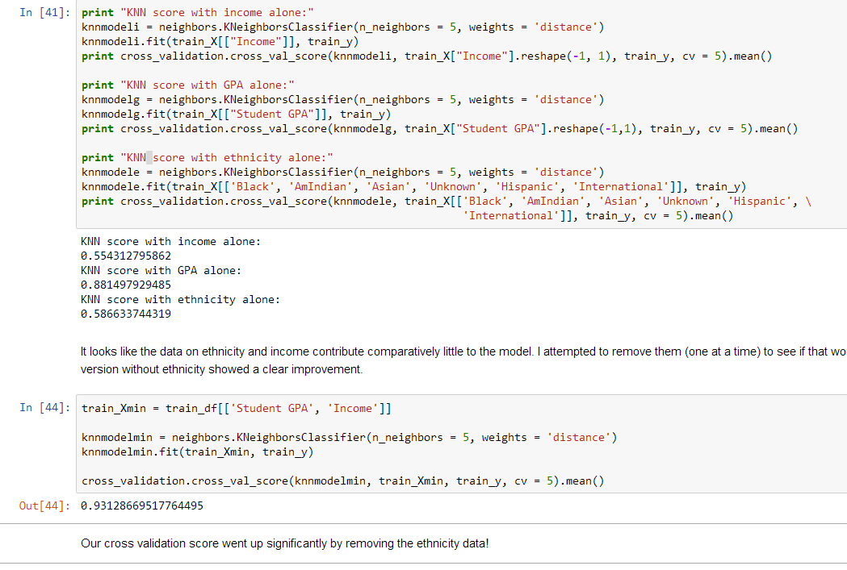
Refining the model (features)

Slide 16
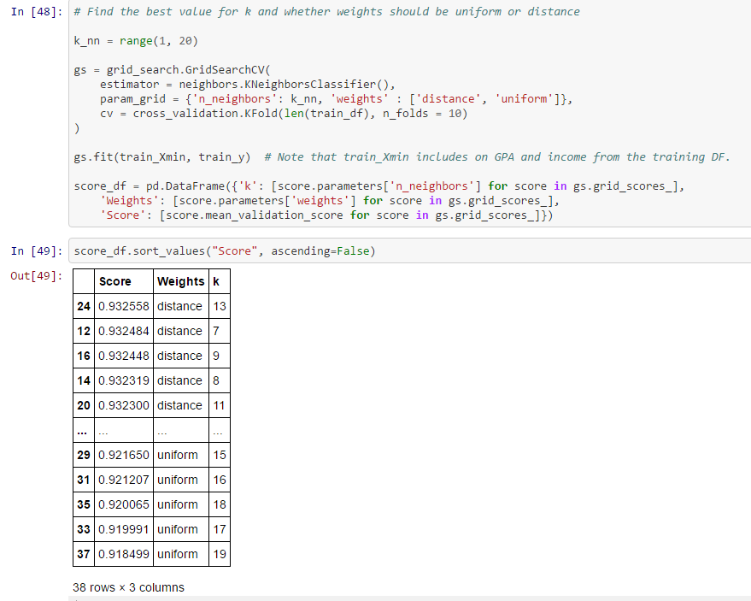
Refining the model (h-parameters)

Slide 17
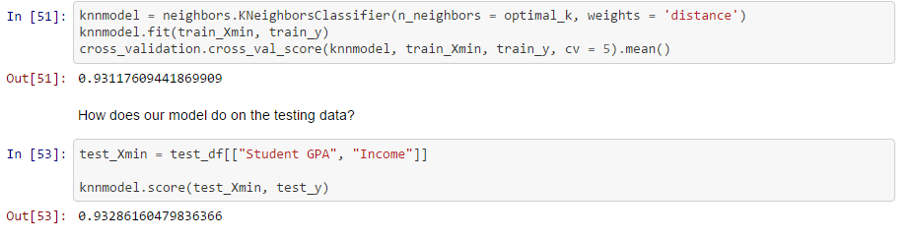
Validating the model
We’ll now score the refined model on the test data:

Slide 18
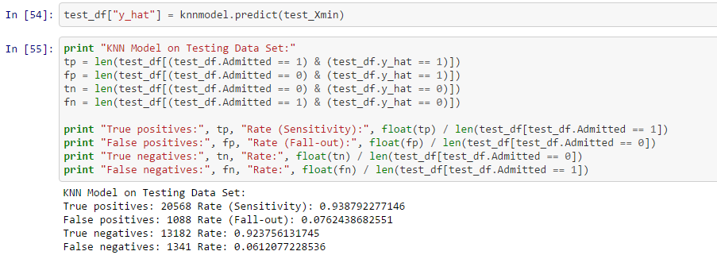
Validating the model
We can make a confusion matrix for the model:

Slide 19
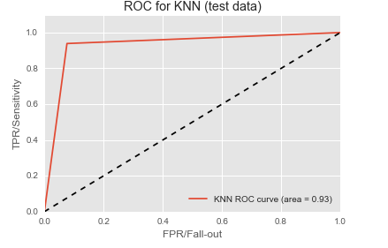
Validating the model
And check its ROC/AUC:

Slide 20
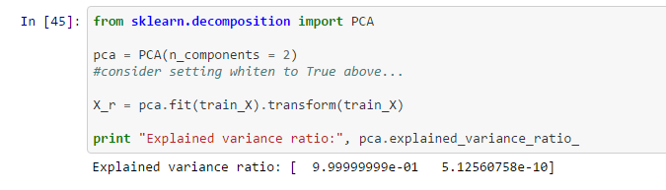
Appendix: Principal Component Analysis
Our model did best when simplified to remove ethnicity. Good news for social justice, but some wasted effort for me!
But still, there may have been some signal there that we can capture by other means…

Slide 21
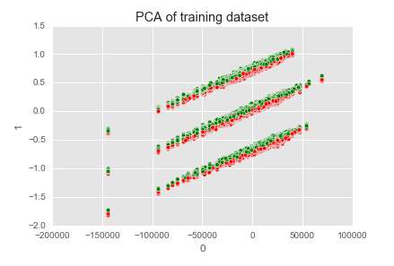
Appendix: Principal Component Analysis
Our model did best when simplified to remove ethnicity. Good news for social justice, but some wasted effort for me!
But still, there may have been some signal there that we can capture by other means…

Slide 22
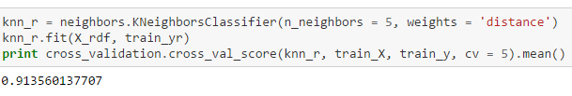
Appendix: Principal Component Analysis
Our model did best when simplified to remove ethnicity. Good news for social justice, but some wasted effort for me!
But still, there may have been some signal there that we can capture by other means…
… now, we can run a basic KNN on the PCA version of the data…

Slide 23
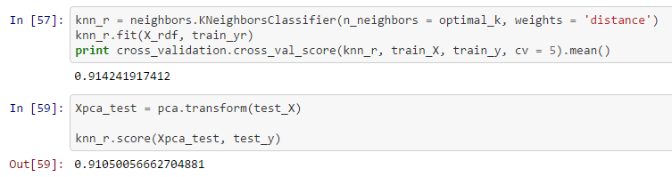
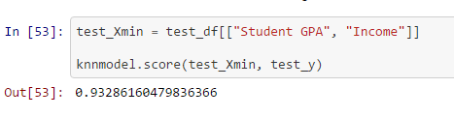
Appendix: Principal Component Analysis
… when we ran a KNN model on the PCA version of our data, however, the results were somewhat worse than our optimized KNN model…

Slide 24
Conclusion
So, the PCA stuff was cool, but our best model is a KNN model that only has student GPA and city income as features. Its predictions are better than 93% accurate!

Slide 25
Conclusion
So, the PCA stuff was cool, but our best model is a KNN model that only has student GPA and city income as features. Its predictions are better than 93% accurate!
To improve the model, we can:
Look into ways of bringing down the false positive rate!
Look into finding the zip codes of the high schools, so income will be evaluated by zip code rather than by city (consider Los Angeles…)
Improve the simulation quality: reduce GPA variance and find out why Asians are under-represented and “unknowns” are over-represented…

Slide 26
Acknowledgements
Thanks to Ivan Corneillet, Bob Stark, and my GA classmates!
(That is to say: thanks, y’all!)

